Slide 1
Introduction
The following slides contain a logical depiction of Bayer’s information supply chain.
The slides are not exhaustive of the entire architecture, however, gives a good idea how it logically fits together.
Git has code examples that provide some insight into my work.
Databricks is all Scala – I like the static typing and case classes it supports. Plus is a little more scalable (hence the name)
Snowflake code examples shows how semi-structured data was handled

Slide 2
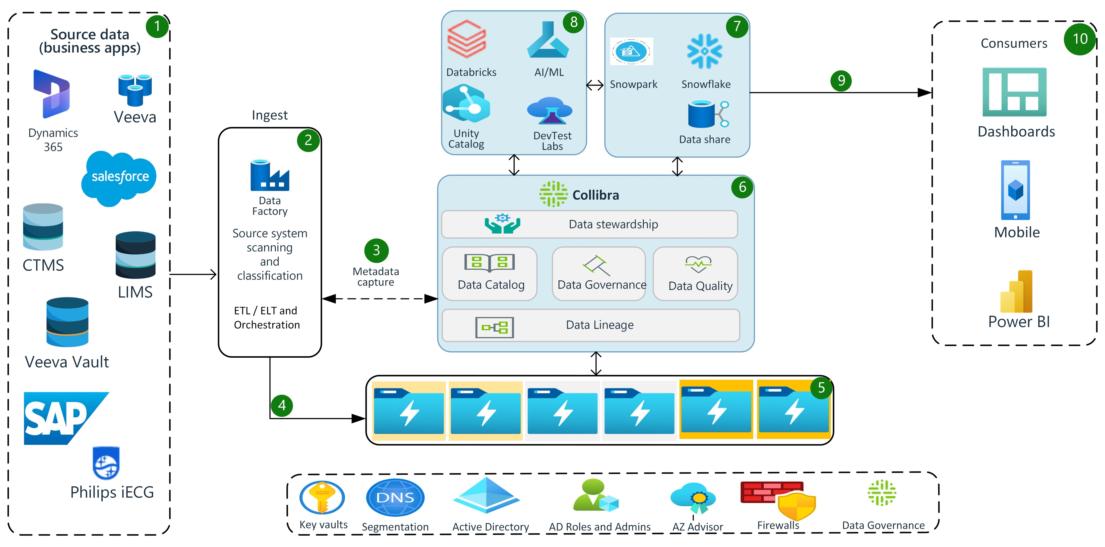

Slide 3
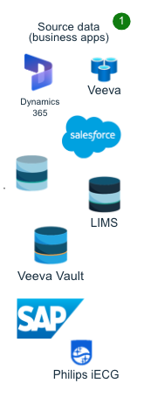
Source System Types
The diagram does not contain a mutually exclusive, nor complete exhaustive list of apps. Below are the categories of systems Bayer is currently ingesting into Snowflake:
Clinical trial management systems (CTMS)
Enterprise resource planning (ERP) systems
Customer relationship management (CRM) systems
Supply chain management (SCM) systems
Healthcare information systems (HIS)
Data analytics platforms
Machine learning platforms
Robotic process automation (RPA) platforms
Cloud-based applications
Web applications

Slide 4
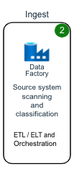
Data Ingestion
Data Factory is used to two ways:
Workflow activities are used/developed to perform ETL
Scheduling and orchestration of workspaces in Databricks
Security:
ADF uses Key Vault to integrate with AZ registered applications and data services.
Active directory is leveraged to ensure role mapping
Interfaces:
1. ADF connects to Collibra for metadata management needs. This may include referencing which hierarchies need to be used for product development.
2. ADF lands data onto ADLS v2 datalake, using a medallion data enrichment pattern.

Slide 5
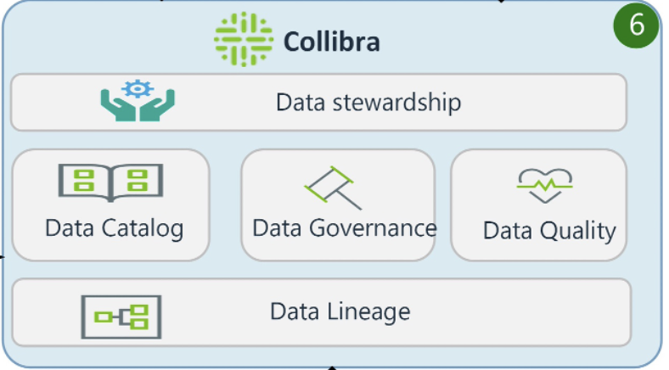
Callibra and Data Governance
Metadata management integral with the entire data pipeline
Data lineage: ADF integrates and pushes notifications describing the processes and transformations taking place
Data Catalog: During ETL, metadata descriptions are being validated, compared, and generated. This allows hierarchies to be be updated as needed and applied consistently across datasets.
Data Governance: Integration with Active Directory, business rules and glossaries are used to qualify data
Data Quality: Rules and business logic are stored and maintained to inform data upon arrival.
Data Stewardship: Security and roles are inherited from AD that ensure people have access to data they are authorized to.

Slide 6
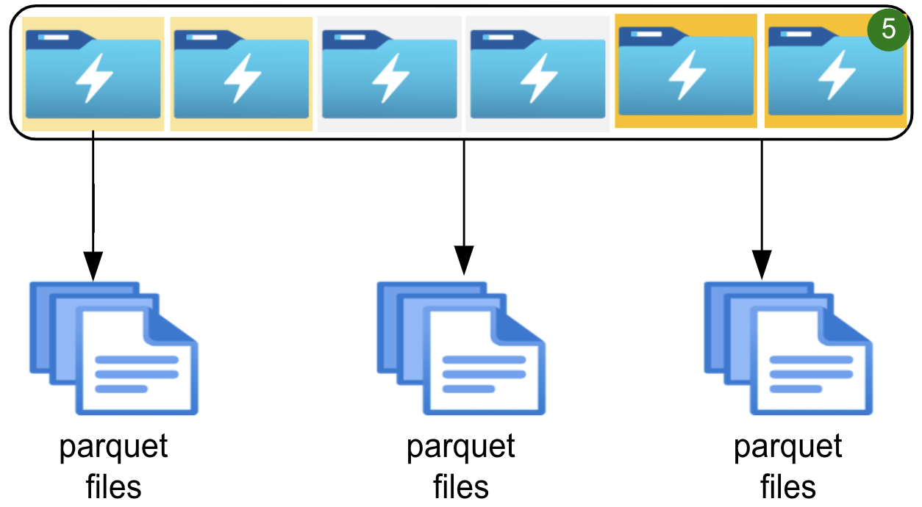
Breakdown of Data Storage
Medallion architecture
Bronze
Silver
Gold
Populated with Parquet files, grouped by application

Slide 7
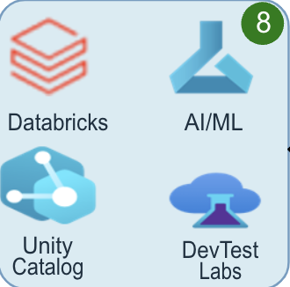
Data Processing Layer
This layer is broken down into 4 tools:
Databricks
Processes data on the datalake through Callibra, using datasets in the catalog.
Data Engineering / and AI/ML Research is conducted
Unity Catalog – Integration point with Callibra
DevTest Labs
AI/ML Services

Slide 8
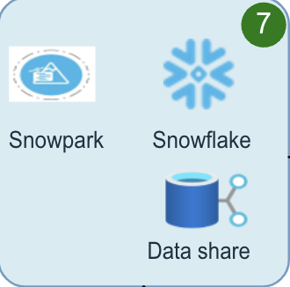
Data Serving and Delivery
Snowflake operates as a serving layer for BI applications
Data shares are leveraged to deliver data to select groups with common data needs. This can be viewed as data marts.
Snowpark is used along side Databricks for EDA, and ETL work within the Snowflake platform.
Snowflake platform allows Databricks to get/put data as needed for Data Science applications

Slide 9
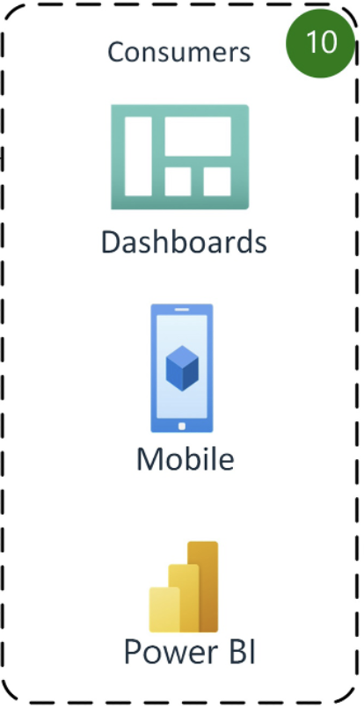
Reporting and Data Delivery
Consumers include decision makers and sales teams on the ground.
Sales teams use predictions to help match providers with Bayer’s products.
Dashboards are consumed by decision makers along with reporting teams

